Slide 1
Navigating the ML Lifecycle with ML Solutions Architecture

Slide 2
Introduction to Machine Learning
Machine Learning (ML) is a transformative technology that enables computers to learn from data and make decisions or predictions.
From its early days, where ML was primarily used in academic research, it has grown to be a cornerstone of modern industries, powering applications from recommendation engines to autonomous vehicles.
With the rapid advancements in ML, new roles have emerged to manage and optimize ML systems, one of which is the ML Solutions Architect, responsible for designing and overseeing the implementation of ML projects.

Slide 3
ML vs. Traditional Software
Traditional Software Development: Relies on explicitly coded instructions to perform tasks. It is rule-based and deterministic.
Machine Learning: Instead of being explicitly programmed, ML models learn from data. They identify patterns in the data and use them to make decisions or predictions.
Advantages of ML:
Flexibility: ML models can adapt to new data without requiring manual updates to the underlying rules.
Scalability: ML systems can handle large, complex datasets that would be impractical to manage with traditional software.
Efficiency: Reduces the need for manual programming and allows automation of tasks that are difficult to codify.

Slide 4
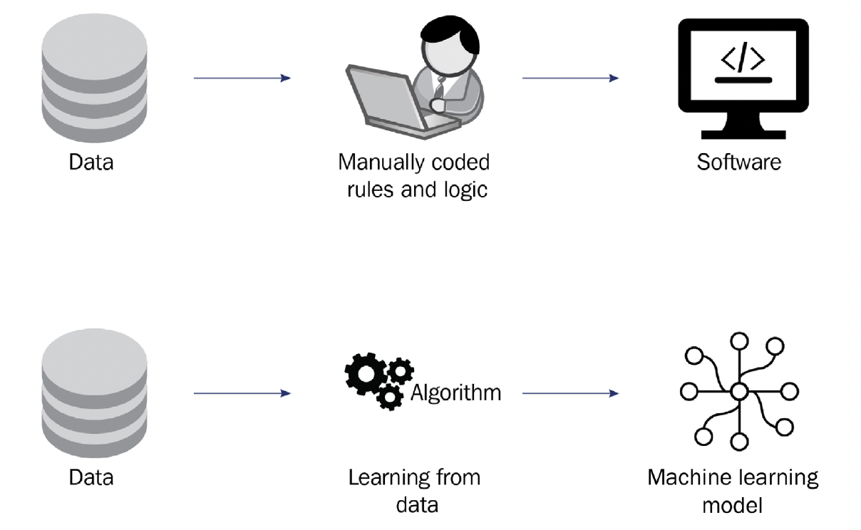
ML vs Computer Software

Slide 5
The ML Lifecycle Overview
Business Understanding: Identify and understand the business problem to be solved with ML.
Data Understanding and Preparation: Gather, clean, and prepare data for analysis.
Model Training and Evaluation: Develop and refine ML models to solve the problem.
Model Deployment: Integrate the ML model into the production environment, where it can be used by end-users.
Visual: Include a flowchart depicting these stages to provide a visual guide for students.

Slide 6
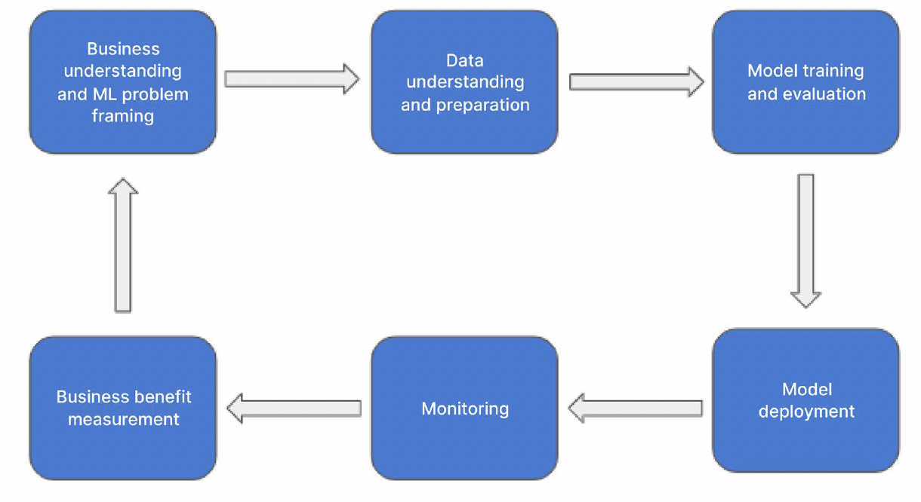
ML Lifecycle

Slide 7
Business Understanding
Define Business Goals: Begin by clearly defining what the business aims to achieve with ML. This could range from increasing sales to improving customer satisfaction.
Determine Metrics for Success: Identify key performance indicators (KPIs) that will be used to measure the success of the ML project.
Assess ML Suitability: Not all problems are suited for ML. Ensure that ML is the right approach by considering the availability of data, the complexity of the problem, and the expected benefits.

Slide 8
Data Understanding and Preparation
Acquire Necessary Data: Collect all relevant data that will be used to train the ML model. This may include structured data (e.g., databases) and unstructured data (e.g., text, images).
Understand Data Relevance: Analyze the data to ensure it is relevant to the business problem. Look for patterns, trends, and potential outliers.
Clean and Prepare Data: Data must be cleaned to remove noise, missing values, or errors. This step also involves transforming the data into a format suitable for ML, such as normalizing values or creating feature sets.

Slide 9
Model Training and Evaluation
Experiment with ML Algorithms: Test various algorithms to determine which one best solves the business problem. Common algorithms include decision trees, neural networks, and support vector machines.
Iterate and Optimize: Fine-tune the model by adjusting hyperparameters, adding more data, or engineering new features. This iterative process helps improve model accuracy.
Evaluate Performance: Use metrics like accuracy, precision, recall, and F1-score to evaluate the model's performance. Ensure the model generalizes well to unseen data by testing it on a validation set.

Slide 10
Model Deployment
Deploy Model to Production: Once the model meets the required performance metrics, deploy it into the production environment where it can start making real-time predictions or decisions.
Integration with Workflows: Ensure that the model integrates seamlessly with existing business workflows. This may involve connecting the model to an application, database, or API.
Collaboration is Key: Effective model deployment requires collaboration between data scientists, software engineers, and operations teams to ensure that the model is scalable, reliable, and secure.

Slide 11
Role of ML Solutions Architecture
Importance of ML Solutions Architects: They play a critical role in managing ML projects, ensuring that the solutions are scalable, secure, and aligned with business objectives.
System Design: ML Solutions Architects design the system architecture, including data pipelines, model storage, and deployment strategies, ensuring they meet performance and scalability requirements.
Automation and Monitoring: They implement automated workflows for model training, testing, and deployment. Monitoring tools are also set up to track model performance and detect any degradation over time.
Security and Compliance: Ensure that ML solutions adhere to industry standards and regulatory requirements, protecting data privacy and maintaining compliance.

Slide 12
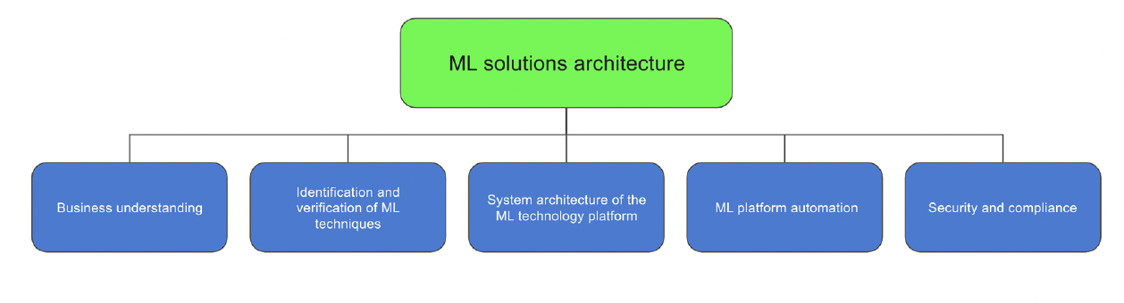
Functional Areas covered by ML Solutions Architecture

Slide 13
Conclusion
Recap: The ML lifecycle consists of four main stages: business understanding, data preparation, model training, and deployment. Each stage is crucial for the success of an ML project.
ML Solutions Architect's Role: ML Solutions Architects ensure that these stages are implemented effectively, bridging the gap between data science and business objectives.
Final Thought: Aligning ML projects with business goals is essential for driving meaningful outcomes and maximizing the value of ML investments.

